Slide 1
Bankruptcy Prevention

Slide 2
Objective
The data were collected from the Taiwan Economic Journal for the years 1999 to 2009. Company bankruptcy was defined based on the business regulations of the Taiwan Stock Exchange.
Total 95 X variables given, and 1 Y variable given in which 1 represents Bankrupt company and 0 represents Solvent company
Based on the variables defined above, we need to build classification models to predict if a company is likely to be Bankrupt or Solvent.
Build as many classification models as possible and check for model performance and accuracy.

Slide 3
Pre-processing steps followed
Imported data into Jupyter notebook
Checked for type of data only integer and float data is present in dataset
Renamed column names
Checked for null values in dataset there are none
Checked for duplicates in data frame there are none
Checked for NAN values in dataset there are none

Slide 4
EDA Observations
Computed the descriptive statistics of our features
Through df.info(), we observed that we have a majority of "float64" data. The categorical data is distinguished as binary 1 and 0, thus stored as "int64". We separate the numeric and categoric data to analyze our dataset.
There are only three categorical data columns, we have first explored these columns 'Bankrupt', ' Liability-Assets Flag', ' Net Income Flag'

Slide 5
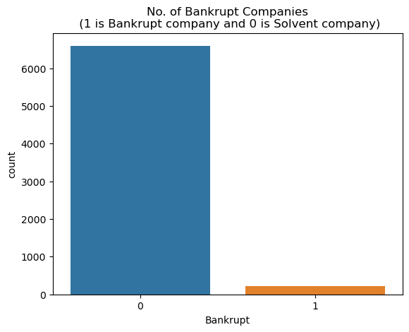
While doing EDA for column Bankrupt we observed
Solvent companies: 96.77 % of dataset
Bankrupt companies: 3.23 % of dataset
As above we can see data is highly skewed as 96% of the companies are solvent in the dataset
Looking at the plot above we can clearly see how our labels are strongly unbalanced, and this is a the main obstacle that we need to solve to obtain good performances.

Slide 6
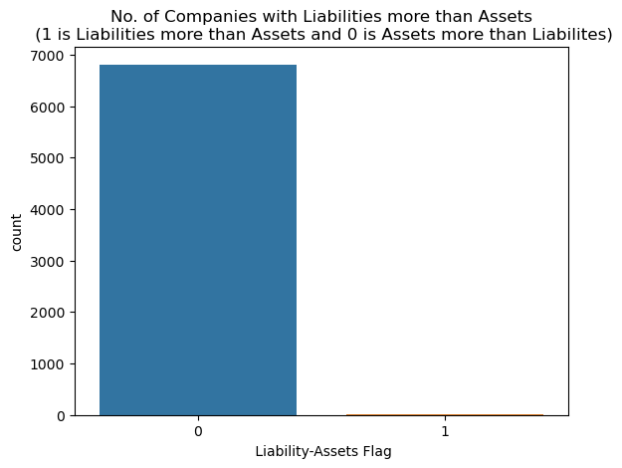
5. While doing EDA for column Liability-Assets Flag we observed
Assets more than Liabilities: 99.88 % of dataset
Liabilities more than Assets : 0.12 % of dataset
The "Liability-Assets" flag denotes the status of an organization, where if the total liability exceeds total assets, the flagged value will be 1, else the value is 0. A majority number of times, organizations/company's assets are more than their liabilities.

Slide 7
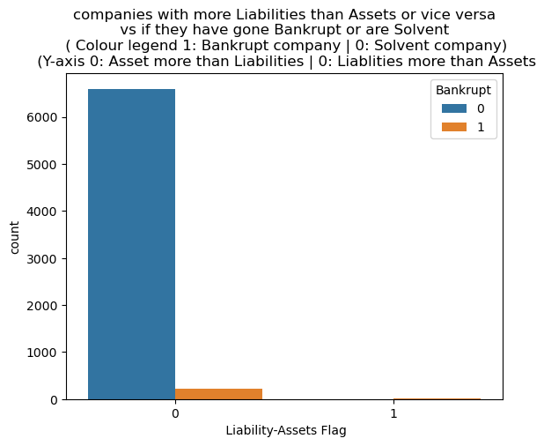
A small portion of organizations suffers bankruptcy, although possessing more assets than their liabilities.

Slide 8
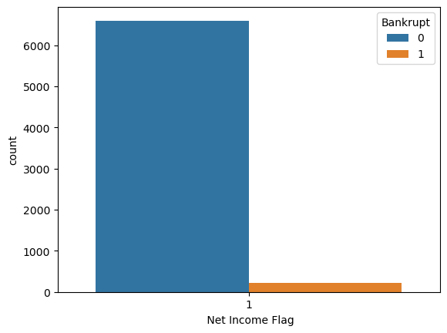
6. The "Net Income" flag denotes the status of an organization's income in the last two years, where if the net income is negative for the past two years, the flagged value will be 1, else the value is 0. We observe that all the records have been exhibiting a loss for the past two years.
Many organizations that have suffered losses for the past two years have stabilized their business, thus avoiding bankruptcy.

Slide 9
Summary of observations in EDA
The number of organizations that have gone bankrupt in 10 years between 1999 – 2000 is few.
Several companies possess many assets, which is always a good sign for an organization.
An organization cannot guarantee not being bankrupt, although owning several assets.
The organizations in the dataset are running into losses for the past two years as their net income poses to be negative.
Very few of the organizations that have had negative income in the past two years suffer from bankruptcy.
It is observed that “Debt Ratio %, Current Liability To Assets, Current Liability To Current Assets" attributes are a few of the attributes that have a high correlation with the target attribute.
An increase in the values of the attributes “Debt Ratio %, Current Liability To Assets, Current Liability To Current Assets” causes an organization to suffer heavy losses, thus resulting in bankruptcy.
An increase in the values of the attributes that have a negative correlation with the target attribute helps an organization avoid bankruptcy.
There seems to be a relation between attributes that have a high correlation with the target attribute and a low correlation with the target attribute.
We observed several correlations among the top 12 attributes, one of which being “Net Worth/Assets and Debt Ratio %” that is negatively correlated with one another.

Slide 10
Data Modeling
Dataset is highly imbalanced. Thus before training the model, we need to deal with this data. Steps followed when we come across an imbalanced dataset.
Split the dataset into training and testing sets (80% - 20%).We preserve the 20% testing set for the final evaluation.
Through "Stratified K Fold Cross-Validation" we will now distribute the 80% training set into further training and testing splits.
Since we are dealing with over 50 features, we use "Randomized Search Cross-Validation" as this technique proves to perform better with many features.

Slide 11
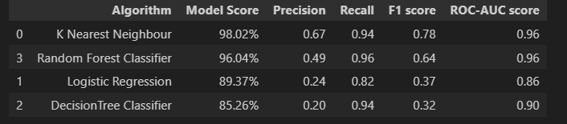
Total data has been trained in 4 machine learning models upon comparison we can conclude
"Random Forest Classifier” has the highest F-1 Score. Thus, we may use these models to train our data.
"SelectKBest" is used to select features that add the most value to the target variable

